Slide 1
question

Slide 2
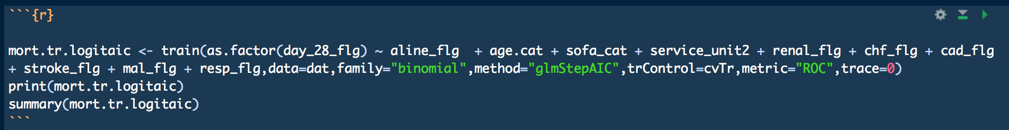
trace=0
what dose it mean?

Slide 3
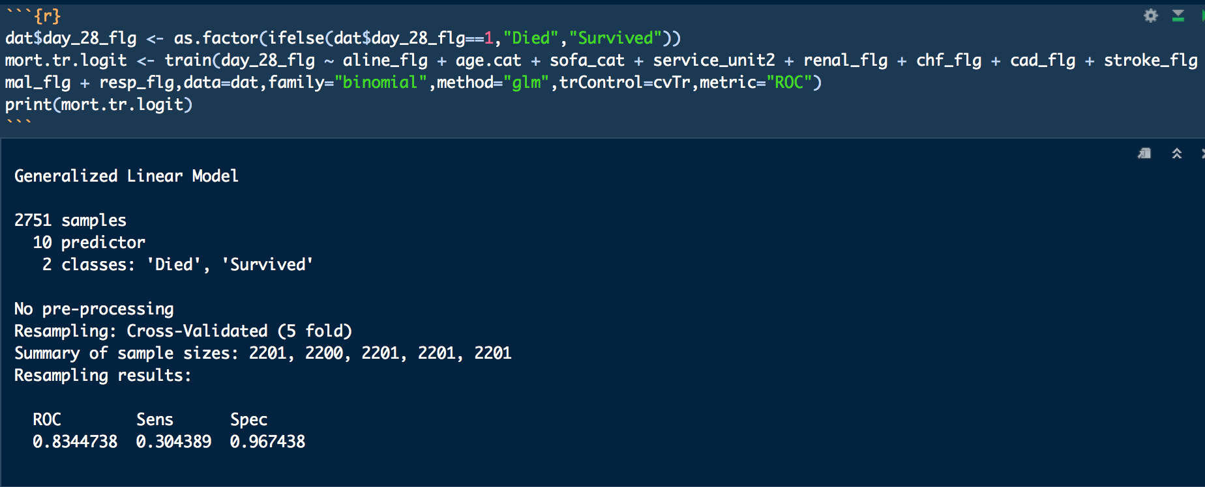
what is a cut off for sen and spe
how is the cut off chosen

